Slide 2
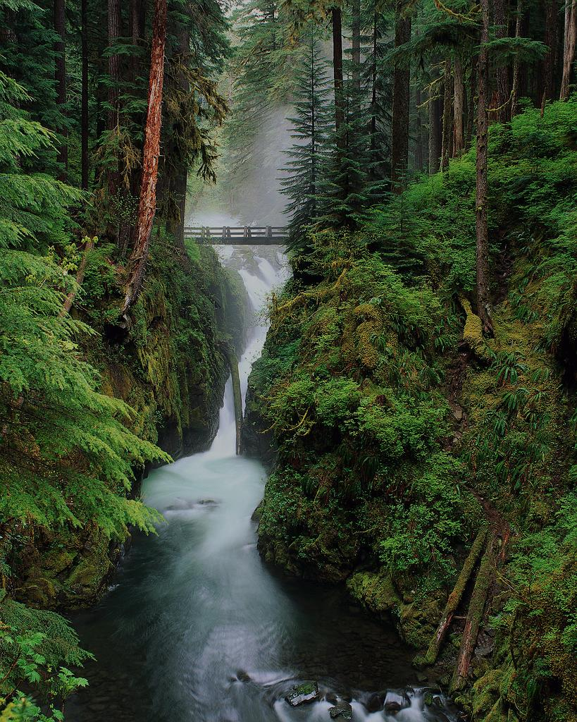
Welcome!
We are glad you have joined us this morning for worship.
As the music begins, please be seated as we prepare for our time of worship together.

Slide 3
¹ Make a joyful noise to the Lord, all the earth! ² Serve the Lord with gladness! Come into his presence with singing! ³ Know that the Lord, he is God! It is he who made us, and we are his; we are his people, and the sheep of his pasture. ⁴ Enter his gates with thanksgiving, and his courts with praise! Give thanks to him; bless his name! ⁵ For the Lord is good; his steadfast love endures forever, and his faithfulness to all generations.
Psalm 100:1-5

Slide 5
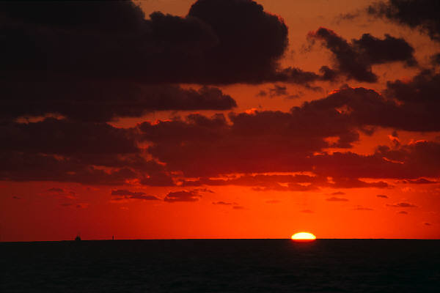
Give thanks to the Lord, our God and King
His love endures forever
For He is good,
He is above all things
His love endures forever
Sing praise, sing praise

Slide 6
With a mighty hand and outstretched arm
His love endures forever
For the life that’s been reborn
His love endures forever
Sing praise, sing praise
Sing praise, sing praise

Slide 7
Forever, God is faithful, forever God is strong
Forever God is with us, forever, forever.

Slide 8
From the rising to the setting sun
His love endures forever
By the grace of God, we will carry on
His love endures forever
Sing praise, sing praise
Sing praise, sing praise

Slide 9
Forever, God is faithful, forever God is strong
Forever God is with us, forever, forever.

Slide 10
His love endures forever,
His love endures forever
His love endures forever,
His love endures forever!

Slide 11
Sing praise, sing praise!
Sing praise, sing praise!

Slide 12
Forever, God is faithful! forever God is strong!
Forever God is with us!
Forever…

Slide 13
Forever, God is faithful! forever God is strong!
Forever God is with us!
Forever, forever.
“Forever” by Tomlin, Chris
© 2001 worshiptogether.com songs (Admin. by EMI Christian Music Publishing); Six Steps Music (Admin. by
EMI Christian Music Publishing)
CCLI #338609

Slide 15

Lord of all creation
Of water earth and sky
The heavens are
Your tabernacle
Glory to the Lord on high

Slide 16
God of wonders beyond our galaxy
You are holy, holy
The universe declares
Your majesty
You are holy, holy

Slide 17
Lord of heaven and earth
Lord of heaven and earth

Slide 18
Early in the morning
I will celebrate the light
When I stumble in the darkness
I will call Your name by night

Slide 19
God of wonders beyond our galaxy
You are holy, holy
The universe declares
Your majesty
You are holy, holy

Slide 20
Lord of heaven and earth
Lord of heaven and earth

Slide 21
Hallelujah (to the Lord of heaven and earth)
Hallelujah (to the Lord of heaven and earth)
Hallelujah (to the Lord of heaven and earth)
You are holy

Slide 22
God of wonders beyond our galaxy
You are holy, holy
Precious Lord reveal
Your heart to me
Father hold me hold me

Slide 23
The universe declares
Your majesty
You are holy, holy, holy, holy

Slide 24
God of wonders beyond our galaxy
You are holy, holy
Precious Lord reveal
Your heart to me
Father hold me hold me

Slide 25
Hallelujah (to the Lord of heaven and earth)
Hallelujah (to the Lord of heaven and earth)

Slide 26
Hallelujah (to the Lord of heaven and earth)
Hallelujah (to the Lord of heaven and earth)
“God of Wonders”
By Marc Byrd, Steve Hindalong
© 2000 Never Say Never Songs (Admin. by Brentwood-Benson Music Publishing, Inc.) | New Spring (Admin. by Brentwood-Benson Music Publishing, Inc.) | Meaux Mercy (Admin. by EMI Christian Music Publishing) | Storm Boy Music (Admin. by EMI Christian Music Publishing)
CCLI # 338609

Slide 28
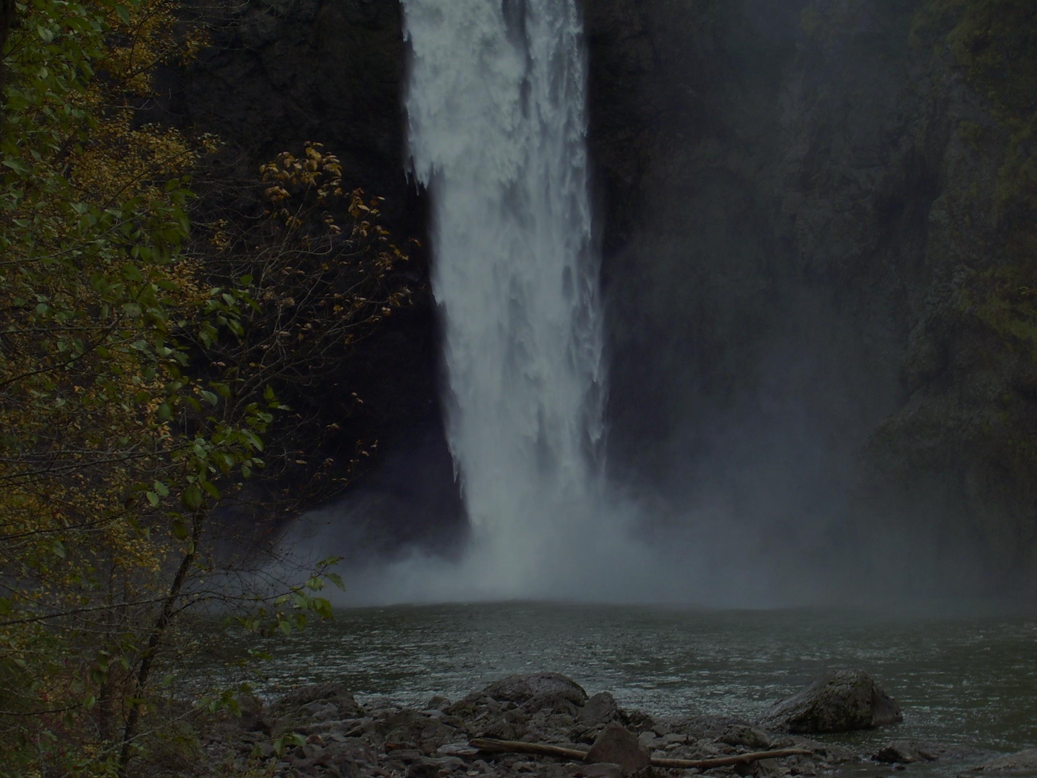
Mountain maker
Ocean tamer
Glimpses of You burn in my eyes
The worship of heaven
Fills up the skies

Slide 29
You made it all
Said let there be
And there was all that we see
The sound of Your voice
The works of Your hands
You do all things well
You do all things well
You do all things well

Slide 30
Star creator
Wind breather
The strokes of Your beauty
Brushed through the clouds
Light from the heavens
Touching the ground

Slide 31
You made it all
Said let there be
And there was all that we see
The sound of Your voice
The works of Your hands
You do all things well
You do all things well
You do all things well

Slide 32
Imagination runs wild
And breathes the breath of life
Across the fields
Across the miles

Slide 33
You made it all
Said let there be
And there was all that we see
The sound of Your voice
The works of Your hands
You do all things well
You do all things well
You do all things well

Slide 34
You made it all
Said let there be
And there was all that we see
The sound of Your voice
The works of Your hands

Slide 35
You do all things well
You do all things well
You do all things well
“You Do All Things Well”
By Chris Tomlin, Jesse Reeves, Michael John Clement
© 2004 worshiptogether.com songs (Admin. By EMI Christian Music Publishing), sixsteps Music (Admin. By EMI Christian Music Publishing), Acoustic Groove Publishing
CCLI #338609

Slide 37
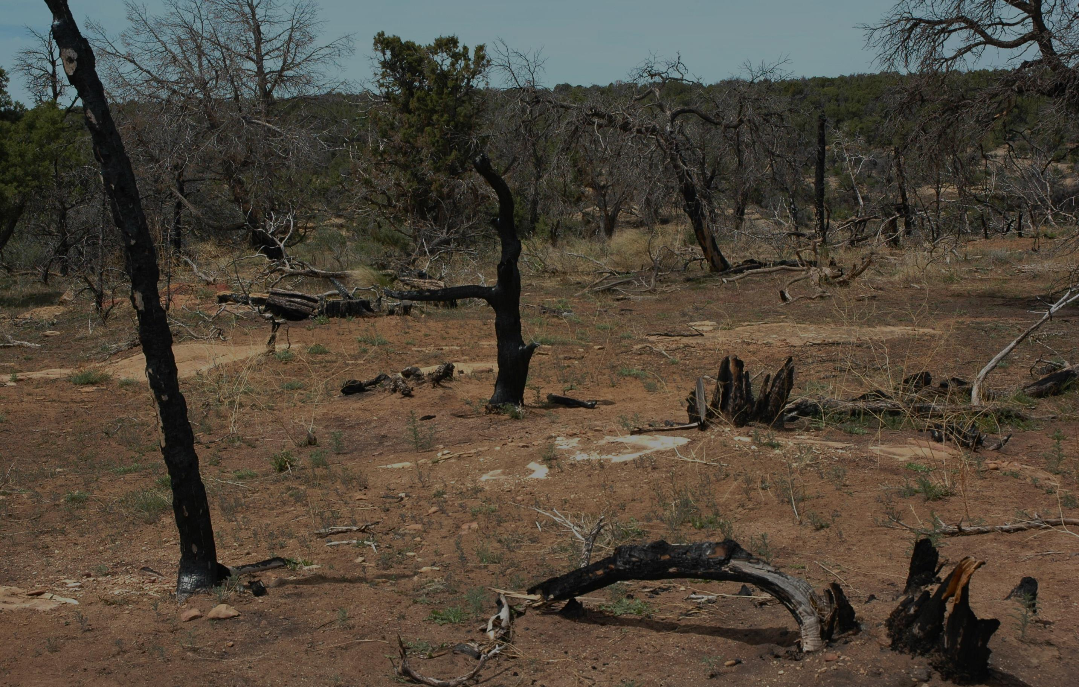
Even though I walk
Through the valley of the shadow of death
Your perfect love is casting out fear

Slide 38

And even when I'm caught
In the middle of the storms of this life
I won't turn back
I know You are near

Slide 39
And I will fear no evil
For my God is with me
And if my God is with me
Whom then shall I fear
Whom then shall I fear

Slide 40
Oh no You never let go
Through the calm and through the storm
Oh no You never let go
In every high and every low
Oh no You never let go
Lord You never let go of me

Slide 41

And I can see a light that is coming
For the heart that holds on
A glorious light beyond all compare

Slide 42

And there will be an end to these troubles
But until that day comes
We'll live to know You here on the earth

Slide 43
And I will fear no evil
For my God is with me
And if my God is with me
Whom then shall I fear
Whom then shall I fear

Slide 44
Oh no You never let go
Through the calm and through the storm
Oh no You never let go
In every high and every low
Oh no You never let go
Lord You never let go of me

Slide 45

Yes I can see a light
That is coming for the heart that holds on
And there will be an end to these troubles
But until that day comes
Still I will praise You
Still I will praise You

Slide 46
Yes I can see a light
That is coming for the heart that holds on

Slide 47
And there will be an end to these troubles
But until that day comes
Still I will praise You
Still I will praise You

Slide 48
Oh no You never let go
Through the calm and through the storm
Oh no You never let go
In every high and every low
Oh no You never let go
Lord You never let go of me

Slide 49
Oh no You never let go
Through the calm and through the storm

Slide 50
Oh no You never let go
In every high and every low
Oh no You never let go
Lord You never let go of me
“You Never Let Go”
By Redman, Matt and Beth
© 2005 Thankyou Music (Admin. by EMI Christian Music Publishing)
CCLI # 338609

Slide 52
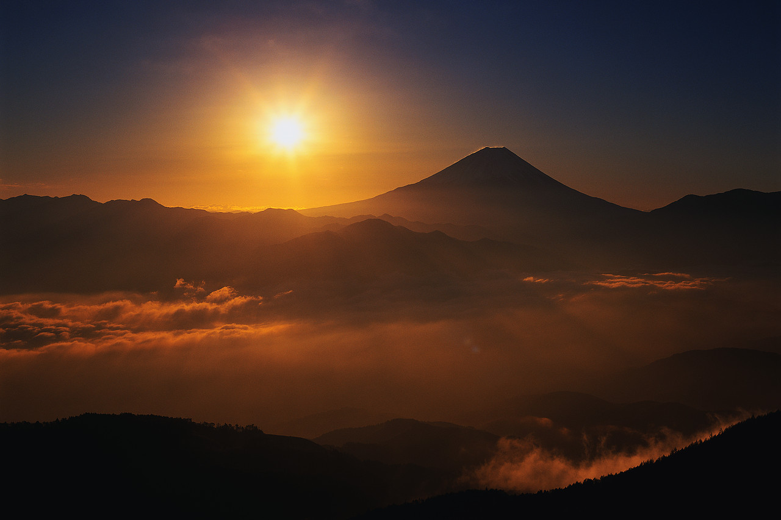
The splendor of the King
Clothed in majesty
Let all the earth rejoice
All the earth rejoice
He wraps Himself in light
And darkness tries to hide
And trembles at His voice
And trembles at His voice

Slide 53
How great is our God
Sing with me
How great is our God
And all will see how great
How great is our God

Slide 54
And age to age He stands
And time is in His hands
Beginning and the End
Beginning and the End
The Godhead three in one
Father Spirit Son
The Lion and the Lamb
The Lion and the Lamb

Slide 55
How great is our God
Sing with me
How great is our God
And all will see how great
How great is our God

Slide 56
Name above all names
Worthy of all praise
My heart will sing
How great is our God
Name above all names
Worthy of all praise
My heart will sing
How great is our God

Slide 57
How great is our God
Sing with me
How great is our God
And all will see how great
How great is our God

Slide 58
How great is our God
Sing with me
How great is our God
And all will see how great
How great is our God
“How Great Is Our God”
By Tomlin, Chris, Reeves, Jesse, and Cash, Ed
© 2004 worshiptogether.com songs / sixsteps Music
CCLI # 338609

